Slide 1
Basic CSI Photography
Presented by KCSO Photo Unit
Angela Van Liew
(206) 296-3835
angela.vanliew@kingcounty.gov

Slide 2
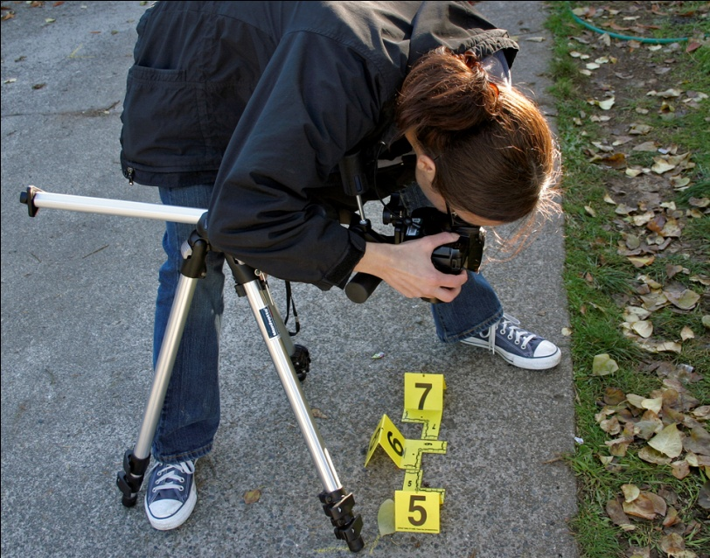
Learning objectives:
Understand the basic principles of photography
Understand the value of quality investigation photos
Understand and follow SOP
Know when to ask for help

Slide 3
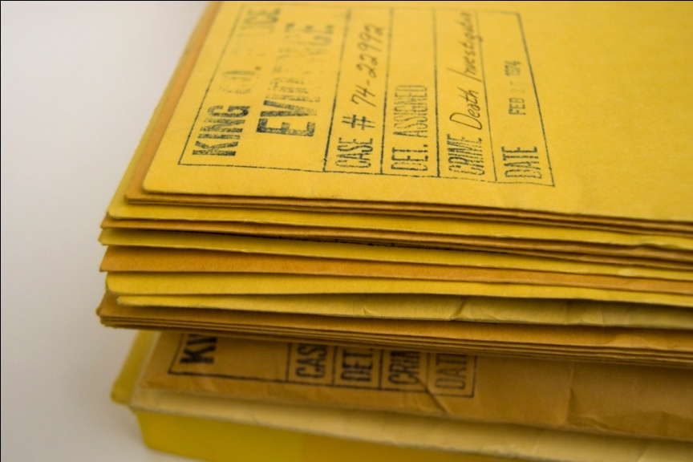
Why do we care if we take good photos?
Good photos provide a permanent record of the scene
Good photos tell the story for future investigators and juries

Slide 4
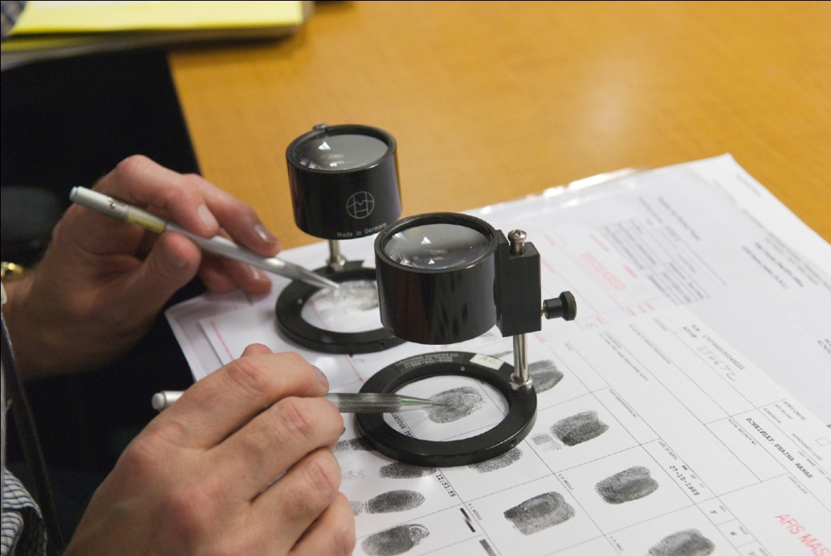
Four Elements Make Great Photos
Composition
Lighting
Exposure
Sharpness

Slide 5
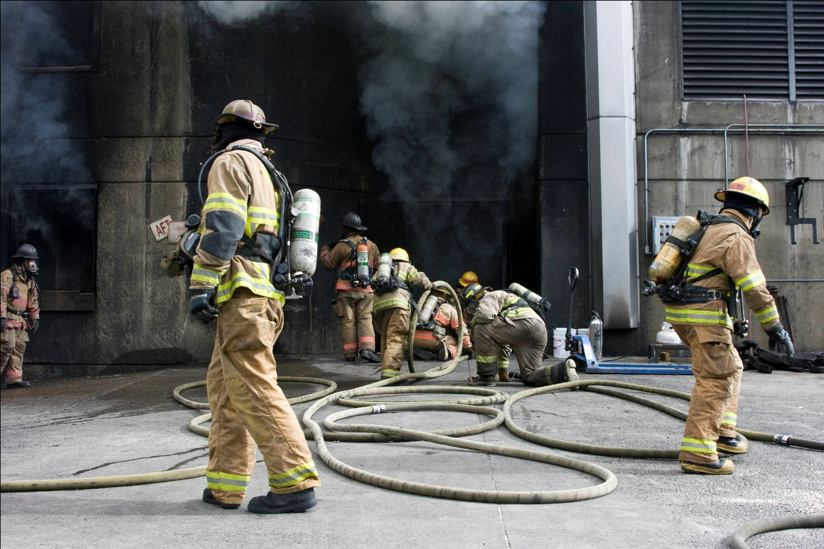
Composition
Choose the best angle, distance, lens
and cropping to tell your story

Slide 6
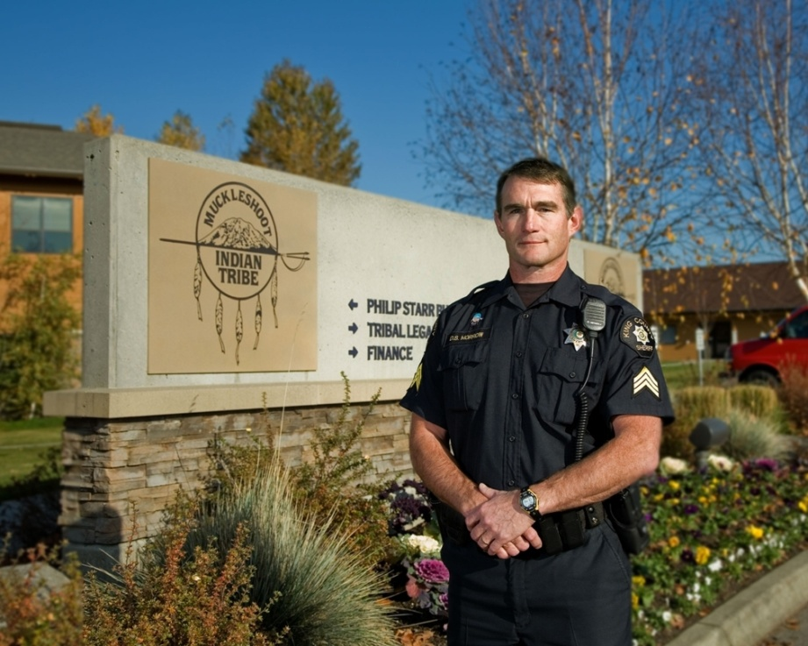
Lighting
Lighting is the most important factor in photography
Without light, you have no photos
Types of lighting
Natural (Ambient)
Flash
Flood lights
Flashlights

Slide 7
Exposure
Choosing the best shutter speed, aperture and ISO to properly record the scene
Auto or Program exposure mode (P) works well for most situations
Large areas of dark or brightness can fool your camera’s meter
The four most common exposure modes are Program (P), Aperture Priority (A), Shutter Priority (S), and Manual (M).

Slide 8
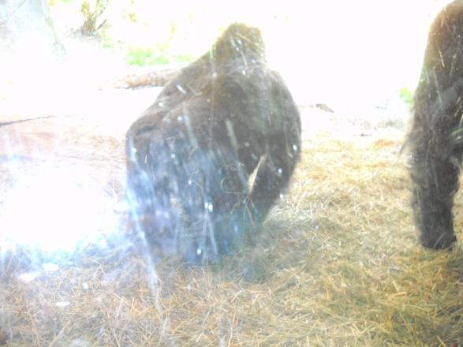
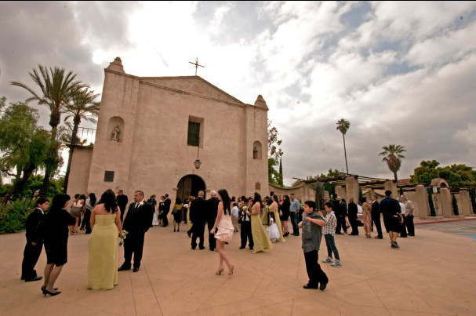
Under Exposure
Over Exposure
Good Exposure

Slide 9
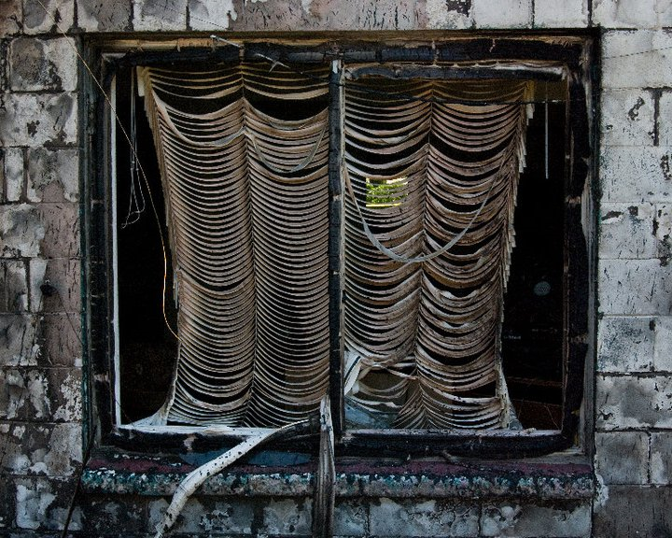
Sharpness
Sharpness is a factor of focus, resolution, and depth-of-field
Sharpness is essential for
good crime scene photos
Save the blurry photos
for your art class

Slide 10
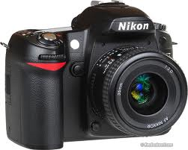
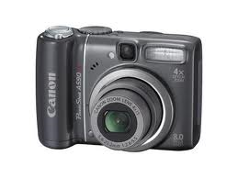
The Camera
The camera is basically a light tight box with a lens for gathering light and a sensor+media to record images.
Most cameras, whether point-and-shoot or dSLR, work quite well using automatic functions (Auto Exposure, Auto Focus, Auto White Balance, Auto Flash)
However, there may be situations where you will need to override those automatic functions

Slide 11
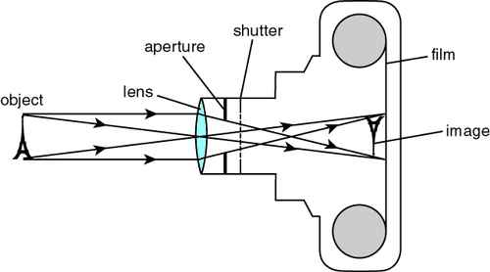
Basic Camera Parts

Slide 12
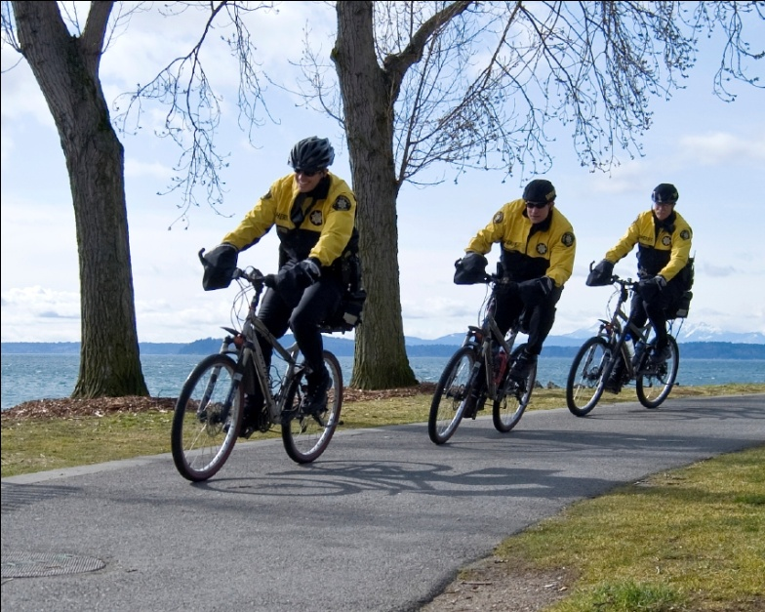
Shutter Speed and Aperture
Work together to:
Make a good exposure
Control motion
Control depth-of-field

Slide 13
Shutter Speed
Adjusting the length of time the shutter is open is one way
of controlling the amount of light that reaches the camera’s sensor
Shutter speeds of less than 1 second are describe in whole numbers but are actually fractions of a second: 250 = 1/250th of a second
Slow shutter speeds may be necessary in low light situations; use a tripod or some other stabilizer to prevent camera motion and blur
Fast shutter speeds are ideal for stopping motion (camera and subject)

Slide 14
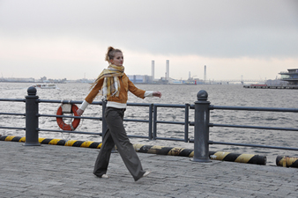
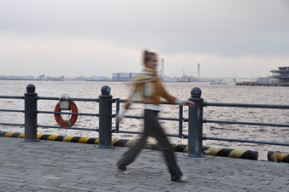
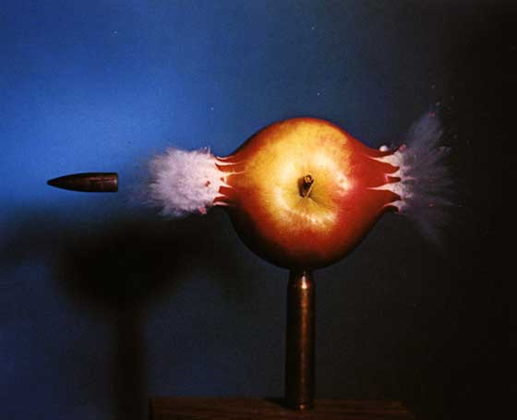
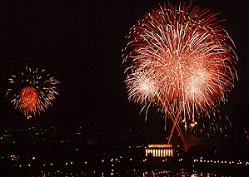
Fast VS. Slow Shutter Speed

Slide 15
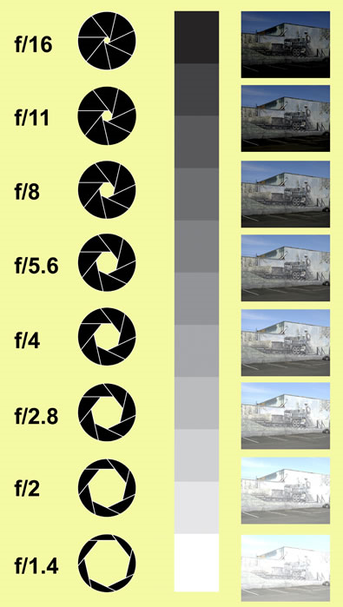
Aperture
The Aperture, also known as the
lens opening, works much like
the pupil of an eye
Aperture sizes are described as f-stops
The higher the f-stop number,
the smaller the opening
The smaller the f-stop number,
the larger the opening

Slide 16
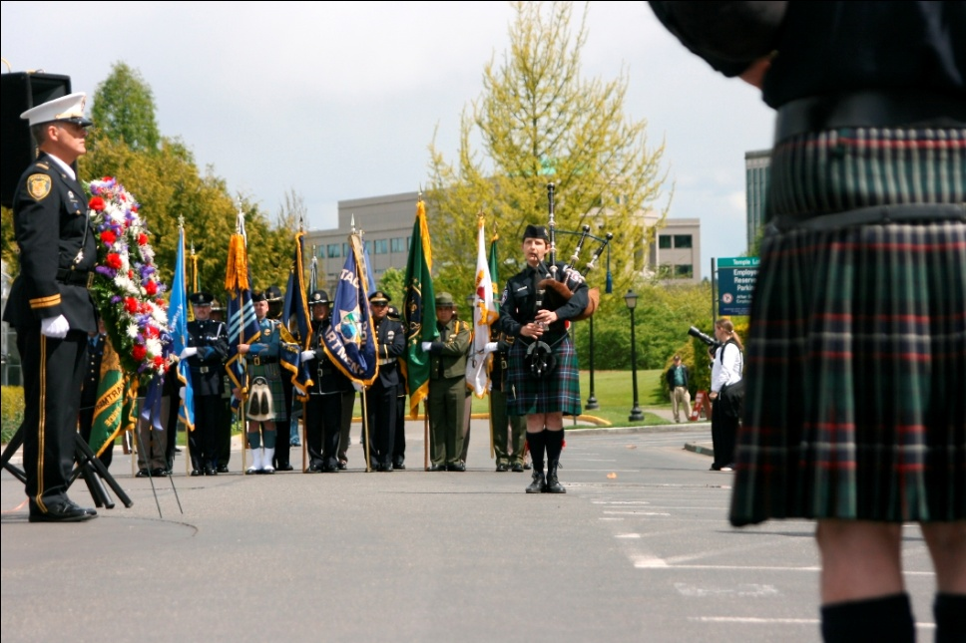
Depth of Field
Depth of field (DOF) is the area from near to far
in a scene that is acceptably sharp
DOF is controlled by:
Aperture size
Lens focal length
Distance from subject

Slide 17
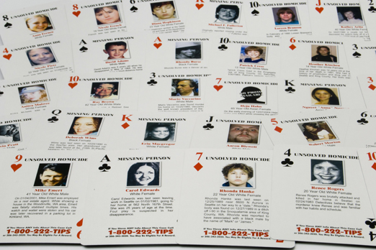
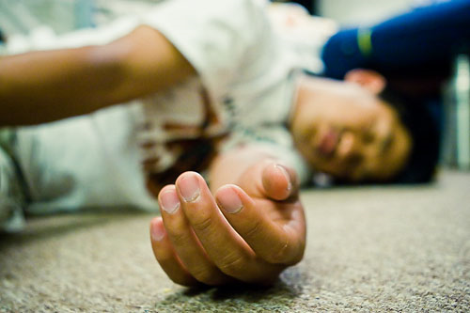
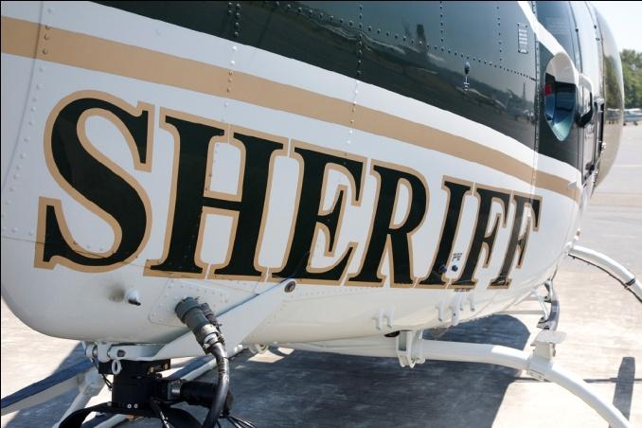
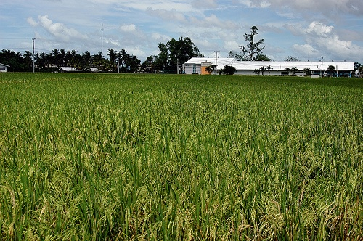
DOF Examples
Shallow DOF (wide open aperture)
Great DOF (small aperture opening)

Slide 18
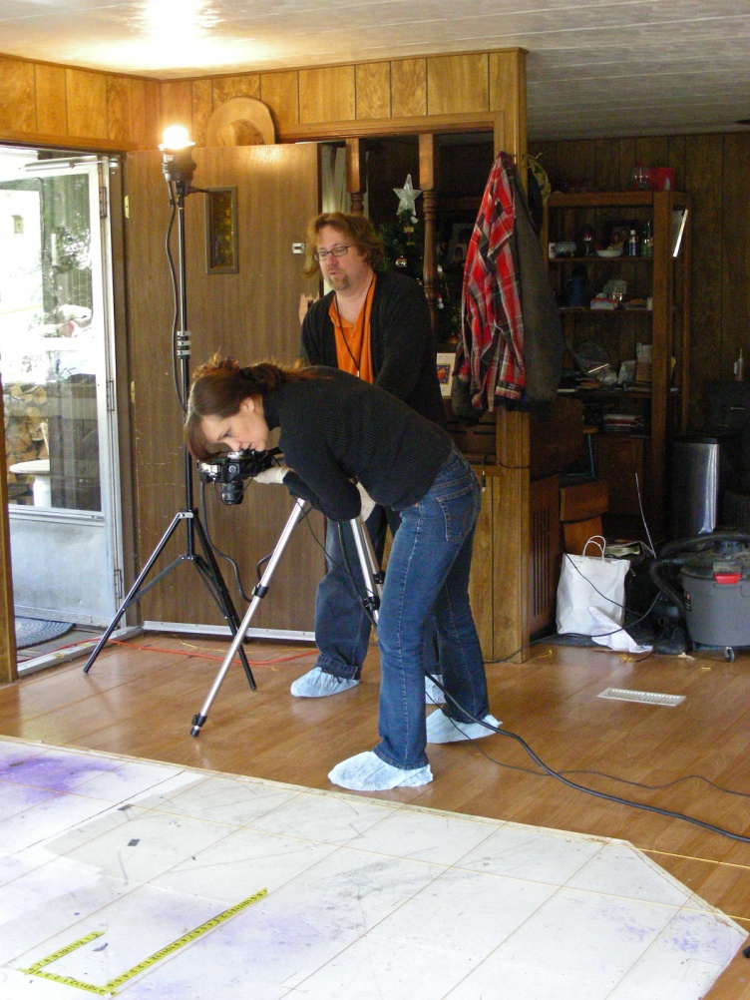
Lighting
Along with the photographer and the camera,
lighting is a key element in photography
Types of Lighting
Available (Existing)
Outdoors
Indoors
Artificial
Flash (Strobes)
Photofloods
Flashlights
Quartz-halogen
Headlights

Slide 19
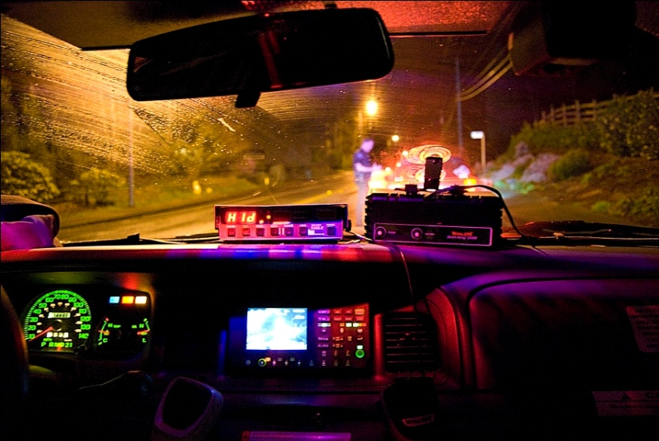
Types of Lighting
Outdoors at night: headlights
Outdoors daytime: sunlight

Slide 20
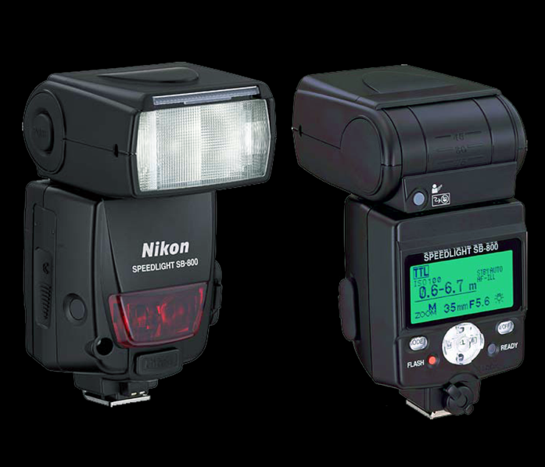
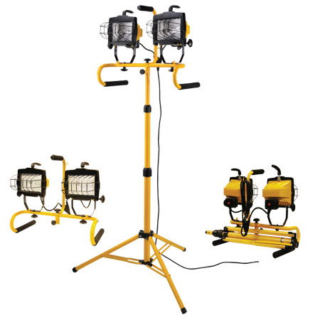
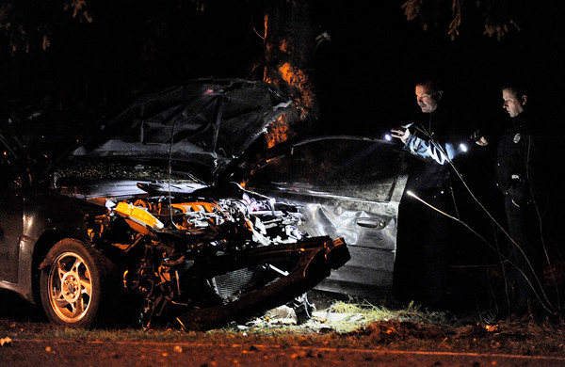
Types of Lighting
Flashes or strobes Quartz-halogen
Flashlights

Slide 21
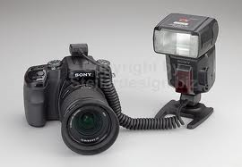
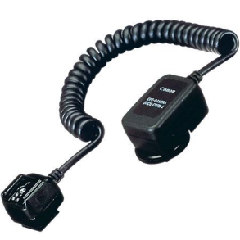
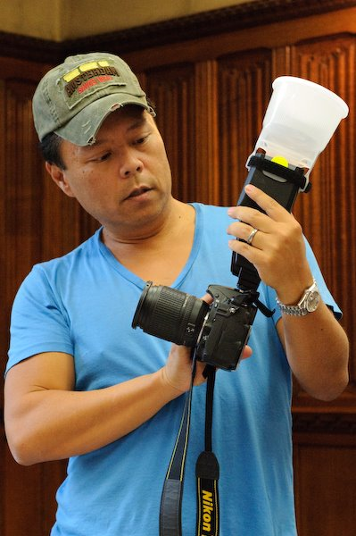
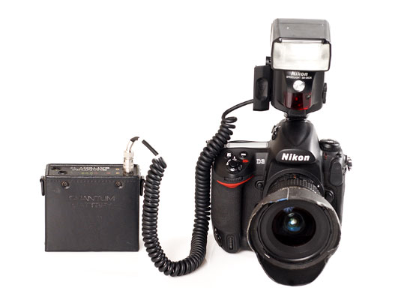
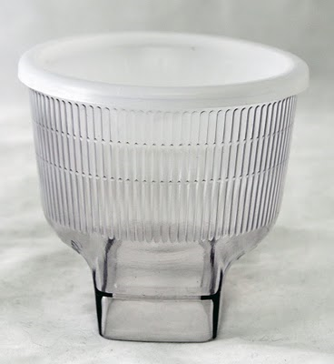
Lighting Accessories
Off-shoe flash cord
Battery packs
Light modifiers

Slide 22
Break Time?

