Slide 1
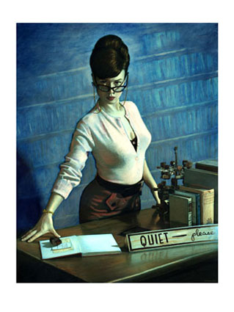
Crime scene photography
Basic Principles

Slide 2
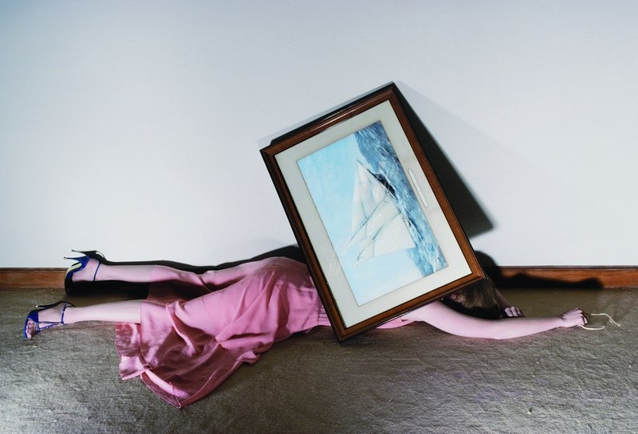
Crime Scene Photography

Slide 3
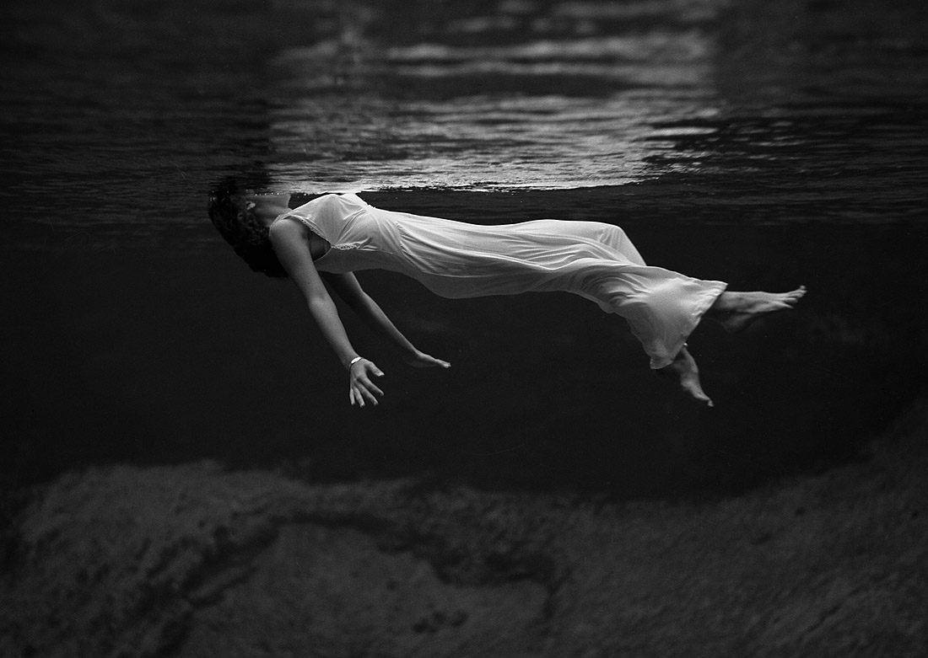
WHY PHOTOGRAPH ?
Crime Scene Photography
To tell a story visually without saying a word
To document your observations as well as what you may not have observed.
A way to capture an area, as it was found after an accident or crime or before a search as a way to record the scene for future reference.
To visually document your activities and procedures that could be questioned later.

Slide 4
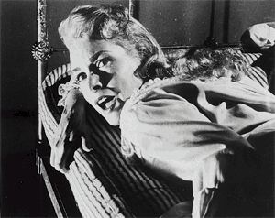
Photography helps investigations by providing information leading to:
Crime Scene Photography
Identification of victims
Identification of suspects
The “story” of what may have happened at the scene
Development of leads based on information or evidence not originally collected
Successful prosecutions

Slide 5
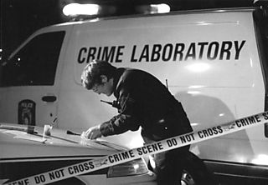
Crime Scene Photography
RECOMMENDED EQUIPMENT
Camera and extra batteries
Medium zoom lens
Close up or macro lens
Polarizing filters
Flash unit and extra batteries
Off camera flash cord and/or sync cord
Remote cord and/or cable release cord (min. 4 ft long)
Tripod
Photo logs
Scales
Extra memory cards

Slide 6
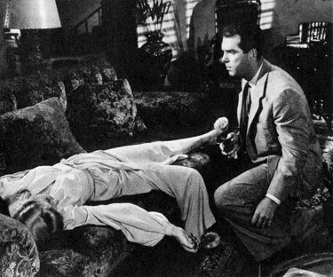
Crime Scene Photography
OPTIONAL EQUIPMENT
1- Photo vest
2- Masking tape
3- Evidence tape
4- Scotch tape
5- Marking pens and a pen that will write on plastic (Sharpie)
6- Clay and/or Play-doh
7- Gray card and/or color checker cards (Macbeth)
8- Lens cleaning paper and solution
9- Flashlight
10- Handy wipes
11- Tape measure
12- Plastic bag that will fit over camera and lens and/or umbrella

Slide 7
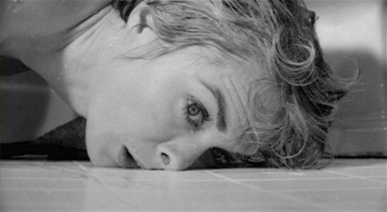
Crime Scene Photography
Before taking the photograph, ask yourself:
What am I trying to do?
How can I best accomplish this?
Answering these questions will help you to decide:
Where to start and what equipment to use
Camera and flash settings

Slide 8
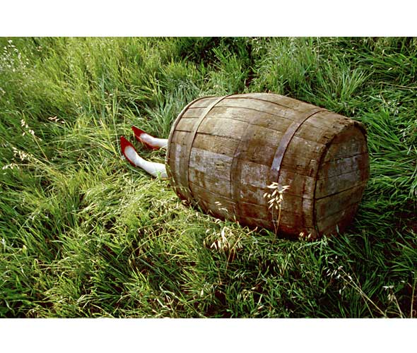
Crime Scene Search Guidelines
Crime Scene Photography
When photographing any search, you should photograph:
BEFORE search is conducted
DURING search as items are found
AFTER search exit photos
Every scene should be photographed using long, medium, close up and close up w/ruler shots.

Slide 9
Crime Scene Plan - Photography at the scene
Crime Scene Photography
Determine the EXTENT and SECURITY of the scene
Conduct preliminary investigation to determine what is involved in the scene and what you will need
BEFORE anything is touched, the scene should be photographed “as found”

Slide 10
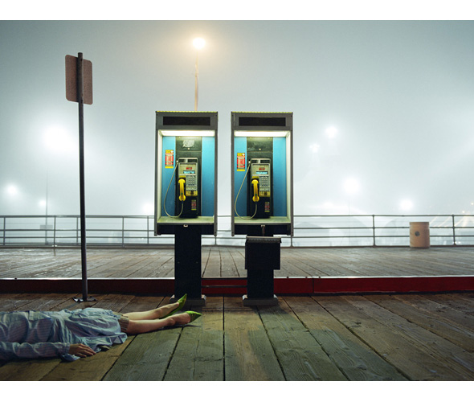
Crime Scene Photography
Take photographs as needed as the investigation develops.
Photographer should remain until scene is completed and “as left” (exit) photographs are taken

Slide 11
What pictures should be taken?
Crime Scene Photography
Your photographic coverage must be complete enough so that a person not at the scene has as thorough an understanding as they would have gotten by being there.

Slide 12
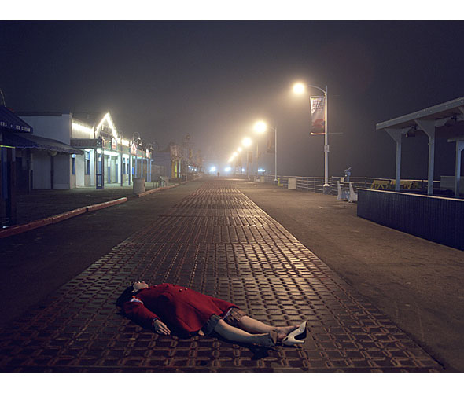
Crime Scene Photography
Don’t make assumptions about what is important. If you have any doubt about the value of a particular picture, TAKE IT! A little extra time doesn’t compare to the cost of failing to record valuable information
YOU CAN’T TAKE TOO MANY PICTURES!

Slide 13
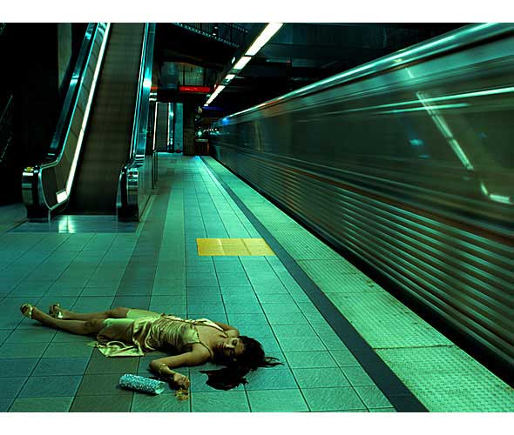
How can I accomplish this?
Crime Scene Photography
Every item of importance (regardless of its size …button or building) should have the following photographs made:
LONG (ESTABLISHING)
MEDIUM
CLOSE-UP
CLOSE UP WITH RULER (if needed)

Slide 14
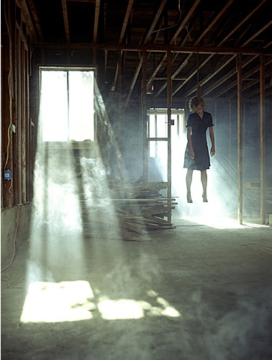
Crime Scene Photography
The LONG (establishing) photograph is taken from as far away as possible to establish where the item is located in its environment. A wide angle lens may be used to accomplish this if necessary

Slide 15
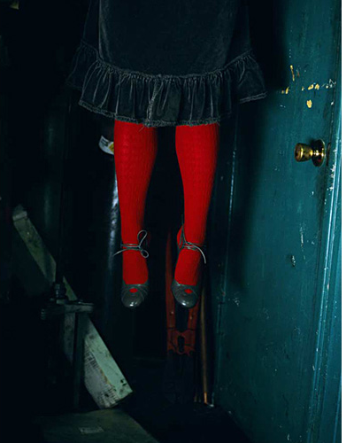
Crime Scene Photography
The MEDIUM photograph shows the item in its immediate surrounding - showing its relative position and distance to other items. The “normal” lens (50mm lens on a full frame dSLR) should always be used for this shot with the camera at eye level. This most closely represents “what you saw”

Slide 16
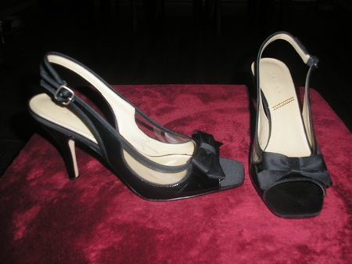
Crime Scene photography
CLOSE-UP photograph is taken from as close as possible to the item.

Slide 17
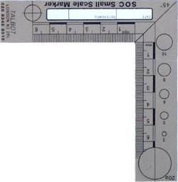
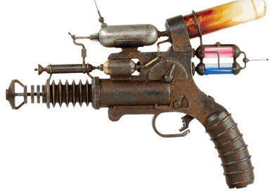
Crime Scene photography
CLOSE UP / WITH RULER
This constitutes a minimum coverage of the scene. Any other photograph needed to accomplish the objective should also be taken.

Slide 18
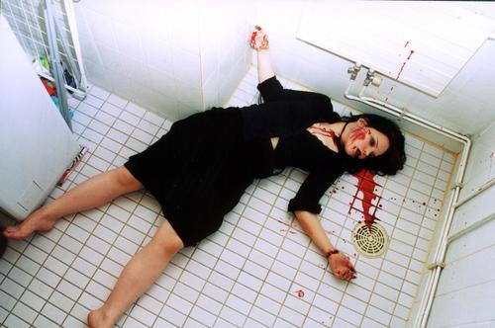
Photographing rooms
Crime Scene Photography
Should be done in a series of overlapping pictures. (depending on the type of scene)
Standing in each corner pointing the camera diagonally across the room may accomplish this.
Holding the camera vertically will yield more information from the floor and ceiling

Slide 19
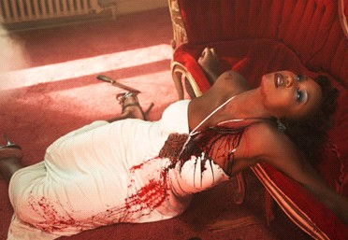
Photographing a body
Crime Scene Photography
Don’t touch the body
Minimum of four views N,S,E,W
Close-up of condition of hands and face (regardless of injury to them)
Close-up of any injuries
Keep Depth of Field in mind since on some photos you will want both head to toes in focus.

Slide 20
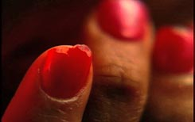
Disturbed items
Crime Scene Photography
Their condition
Their relative position to one another and the surrounding area
Items should be photographed BEFORE they are moved from their original position

Slide 21
Entrances and Exits
Crime Scene Photography
The view in and out
The condition of the area and where it leads to and from

Slide 22
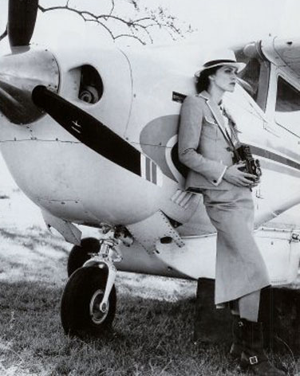
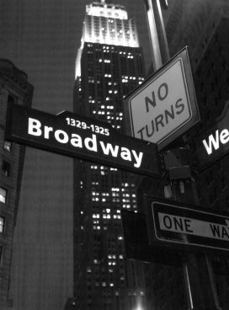
Locators
Crime Scene photography
Adjacent street sign
Aerial photography

Slide 23
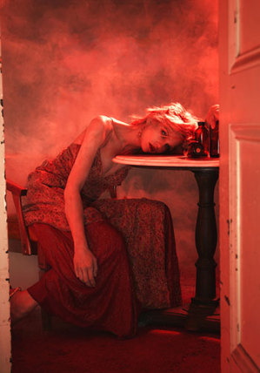
Crime Scene Photography
Make sure that you label rooms
and closets

Slide 24
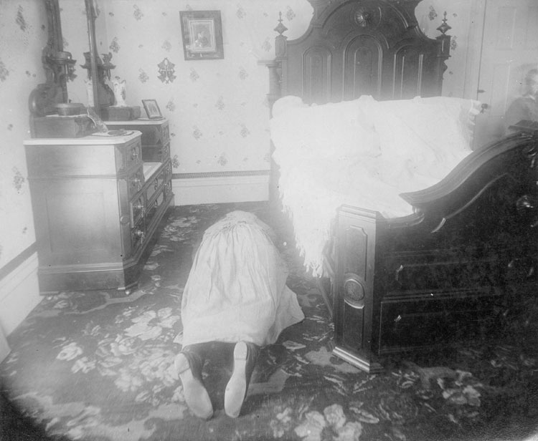
Crime Scene Photography
Make sure when taking EXIT photos that you include the search
Warrant in the photo

Slide 25
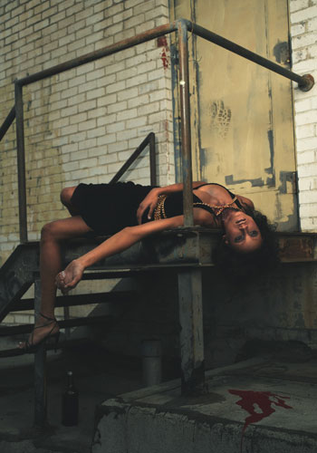
Crime Scene Photography
Any damage that occurred during the investigation should be documented

Slide 26
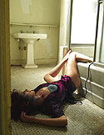
Photograph anything else that may help aid in the investigation.
Crime Scene Photography
REMEMBER
You rarely get a second chance to go back to the scene

Slide 27
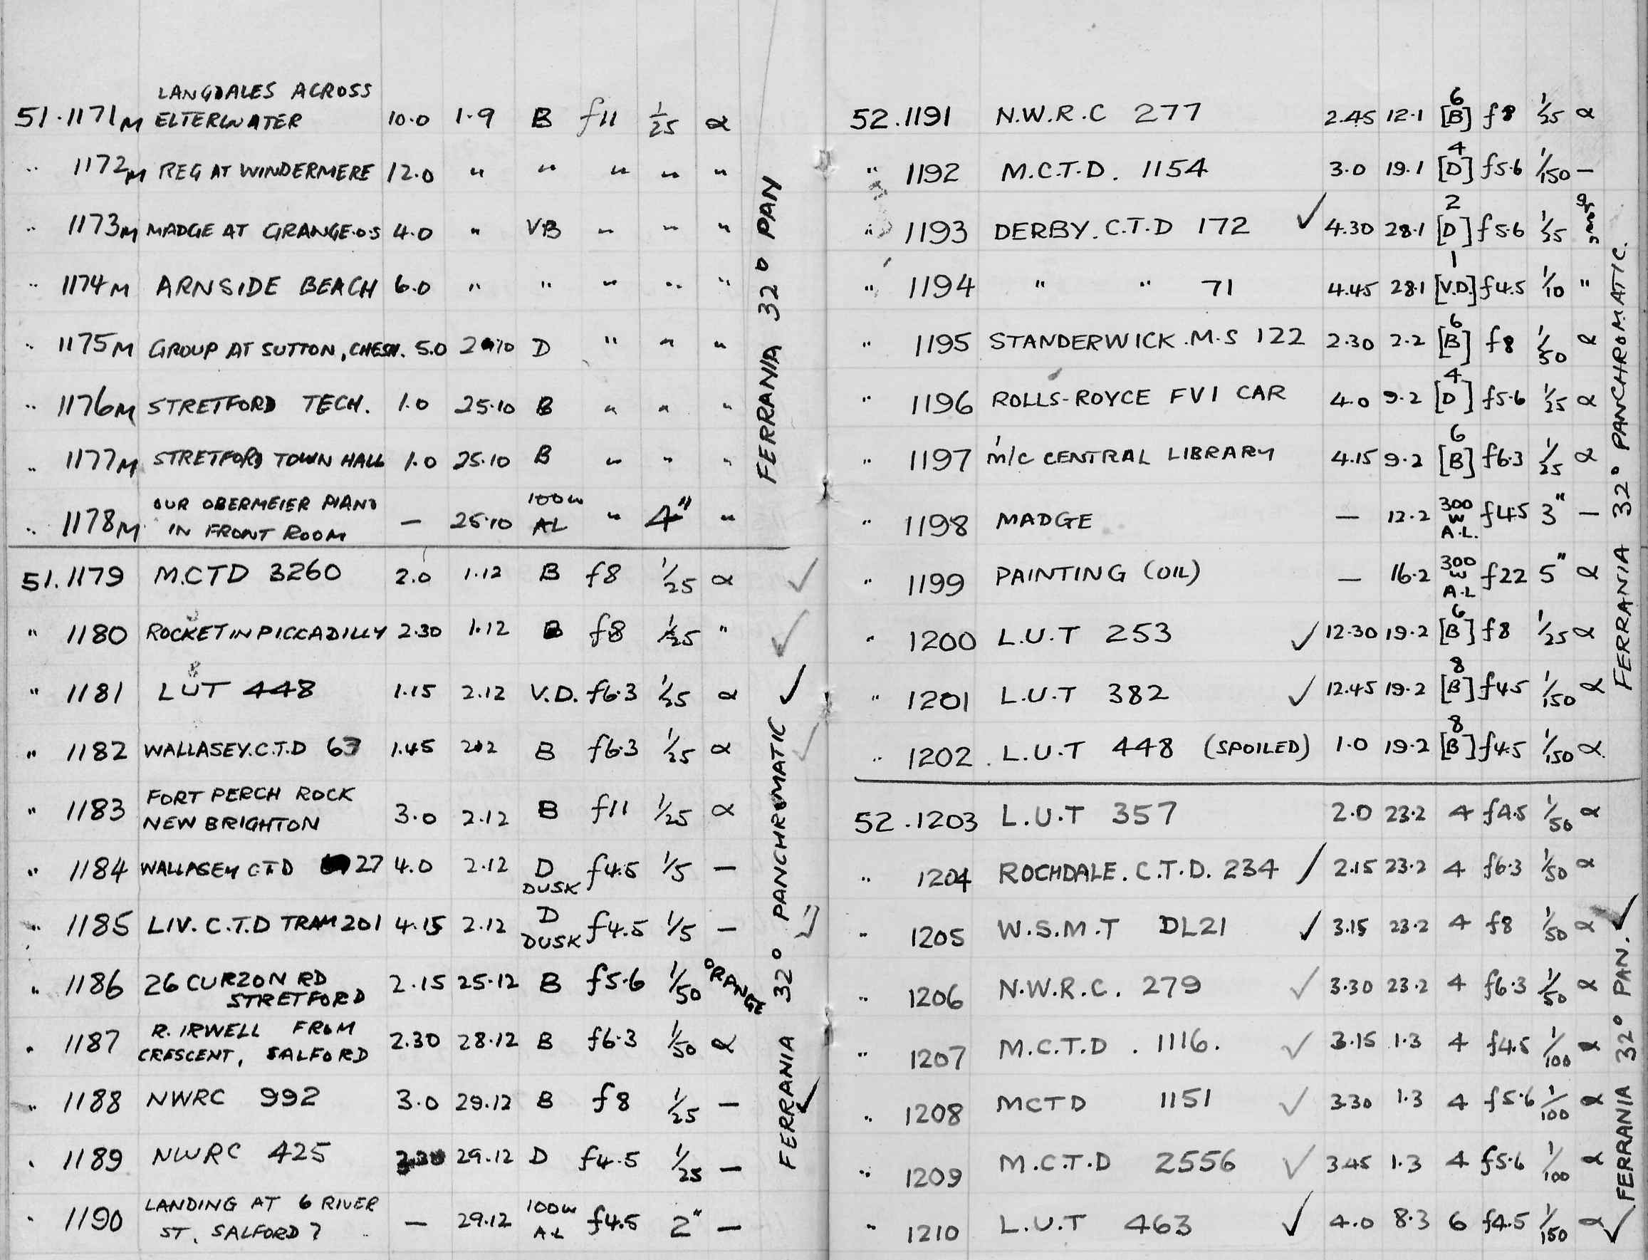
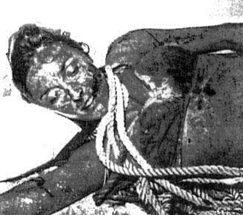
How do I keep it all organized? PHOTO LOG
Crime Scene Photography
A photo log is used for identification - take a photograph of it to aid in identifying each roll.
List photographs and identify the position of the item and the photographer

Slide 28
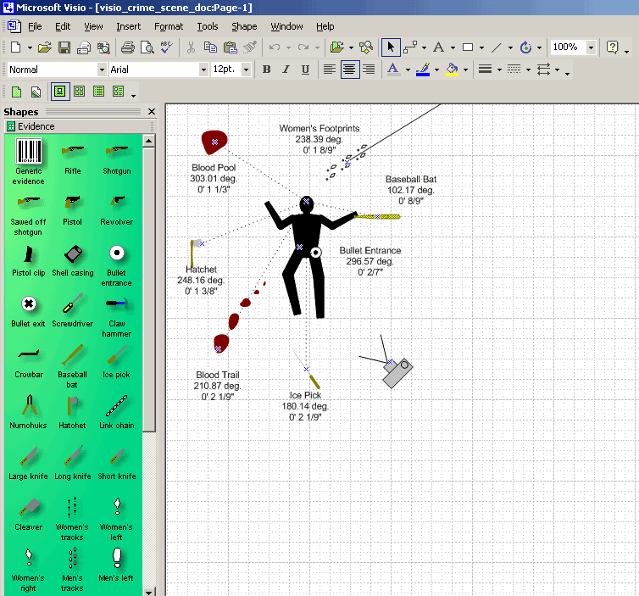
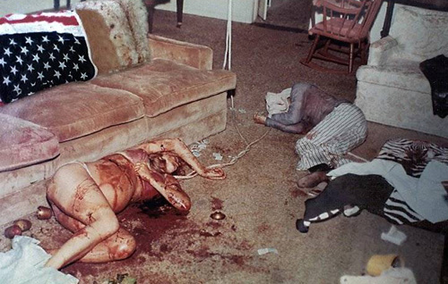
Crime Scene Photography
Only crucial information should be written on the log
Exposure information may be valuable for your own benefit

Slide 29
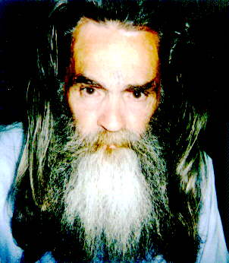
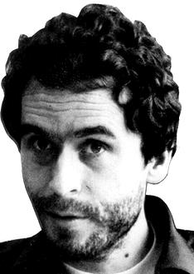
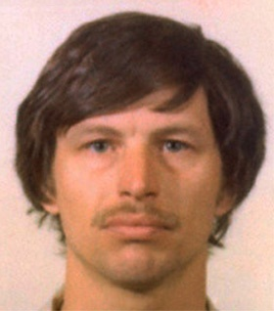
Crime Scene Photography

Slide 30
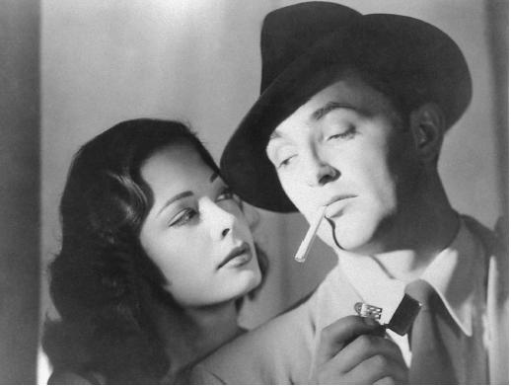
Questions ?

Slide 31
Break ?
Notes:
55

