Slide 1
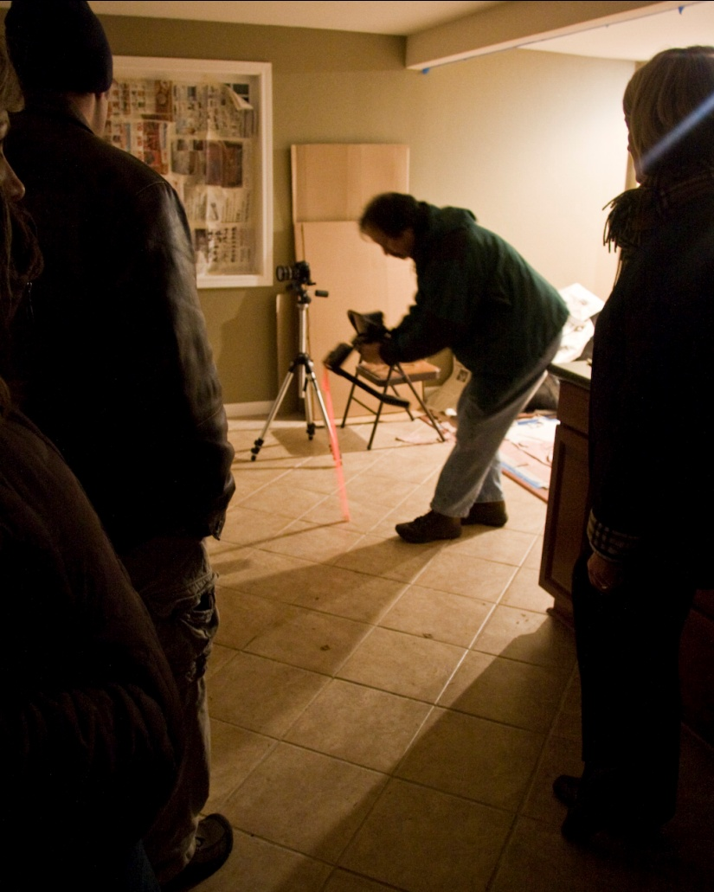
Techniques For Crime Scene Videotaping
Presented by KCSO Photo Unit
Angela Van Liew
(206) 296-3835
angela.vanliew@kingcounty.gov

Slide 2
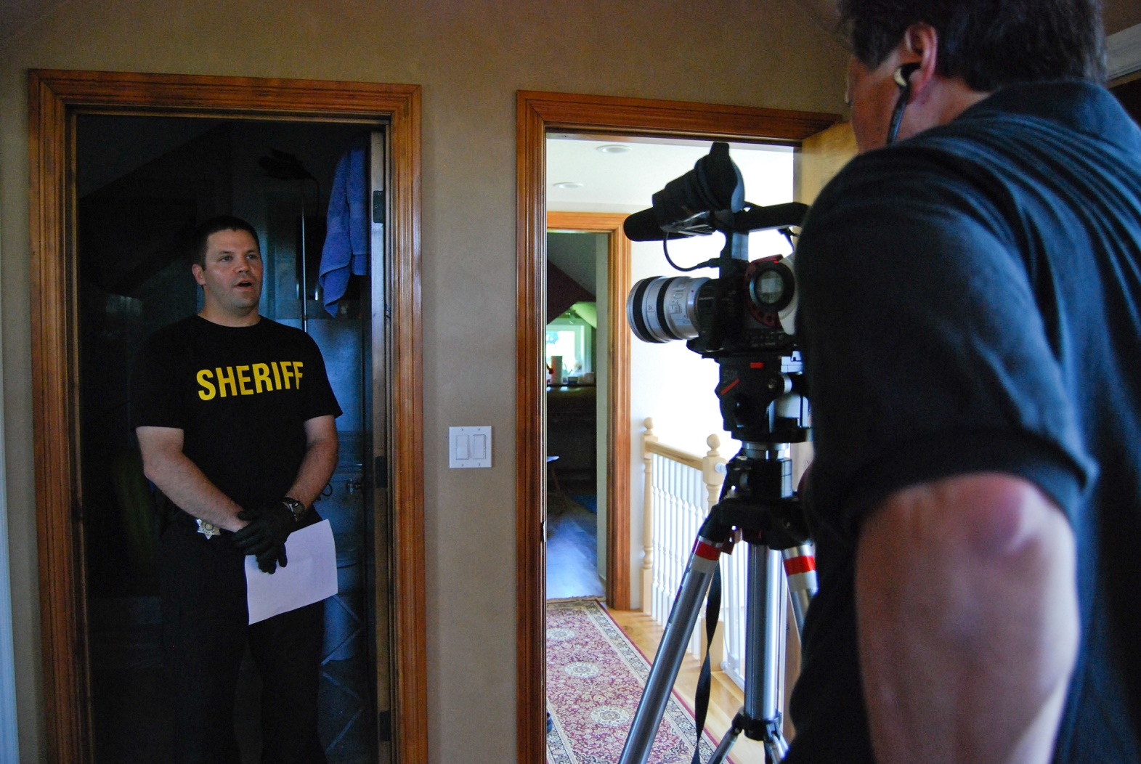
Why videotape?
Great for showing an overview of the crime scene
Should always be used in major cases

Slide 3
Start the video tape with a brief introduction presented by an investigator. This should include:
The date, time, location
Type of crime scene
Any other important introductory information
A brief description of the rooms and evidence
A basic diagram as an illustration
Begin with a general overview of the scene and surrounding area.
Continue throughout the scene using wide angle and close up views to show the layout of the scene, location of evidence, and the relevance of evidence within the crime scene.
While videotaping, use slow camera movements such as panning, and zooming.

Slide 4
Example #1
Potential Liability Case

Slide 5
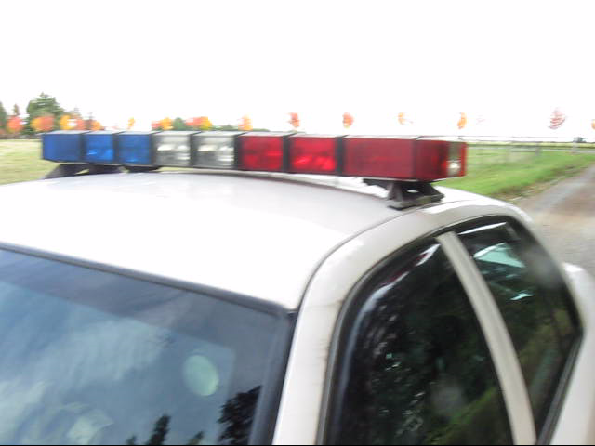
Example #2
Illegal Discharge of Firearm

